Slide 1

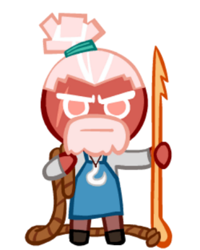
EE439 Final Presentation
Why is it incorrect to call seminar?
Because it is saltminar Ha Ha!
Drive thru this class FAST!
Last Presentation @ B.E. Hoo Hoo!
Avocado! Did you call me? My name is not saltminar!
What will be surprises in this presentation?
He He …

Slide 2
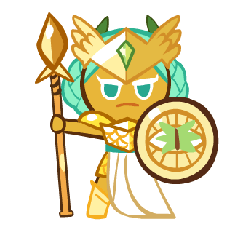
Final Round Rules
Everything should be settled in final round.
This presentation is made to create memorable experiences. The content will not stay long, but what would remain is memory!
Enjoy my upcoming activity, esp designed for the last semester!
To celebrate every hero, this presentation will be exceptionally entertaining!

Slide 3

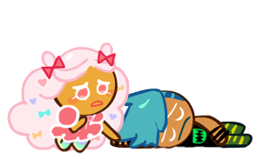
Looking back …
1) Proposal presentation → birds-eye views of my research ideas
Tools : Python notebook
2) Seminar discussion → mock-up example of EPU index
Tools: Python notebook (text mining)
3) Result presentation → detailed walkthrough of my process
Tools: R Markdown
Tired of my presentation yet?

Slide 4

Looking back …
1) Proposal presentation → birds-eye views of my research ideas
Tools : Python notebook
2) Result presentation → detailed walkthrough of my process
Tools: R Markdown
3) Seminar discussion → mock-up example of EPU index
Tools: Python notebook (text mining)
4) Today presentation → Combine both overview and walkthrough
Tools: Pencil and paper (really?)

Slide 5

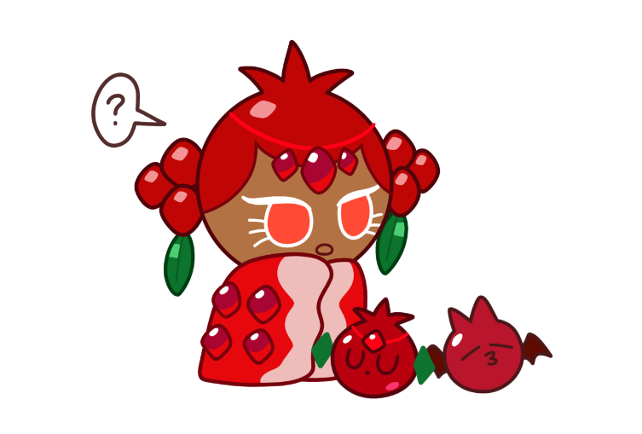
Feel sleepy?
Are you worried about future after B.E.?
Try this “accurate” fortune teller!
https://gooddee.github.io/Destiny_BE/

Slide 6
Feel sleepy?
Why is seminar presentation similar to gacha?
Because seminar work requires luck!
salt

Slide 7

Telling my story from scratch
It is a feature, not a bug!

Slide 8
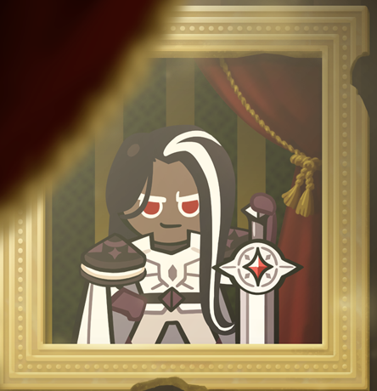
MY journey from first-year to fourth-year
First-Year: Interested in stock trading & finance
Theoretical Economics research must be my seminal paper.
Studying Ph.D. in Econ is a good choice.
Coding, CS: what??
Slide presentation must be highly academic

Slide 9

MY journey from first-year to fourth-year
Fourth-Year: Switch to data science and computer science instead
Empirical paper is enough!
Master in Data Science and no Econ anymore!
Coding, CS: my main tool in this course.
It is not slide presentation. It is you watching my movie!

Slide 10
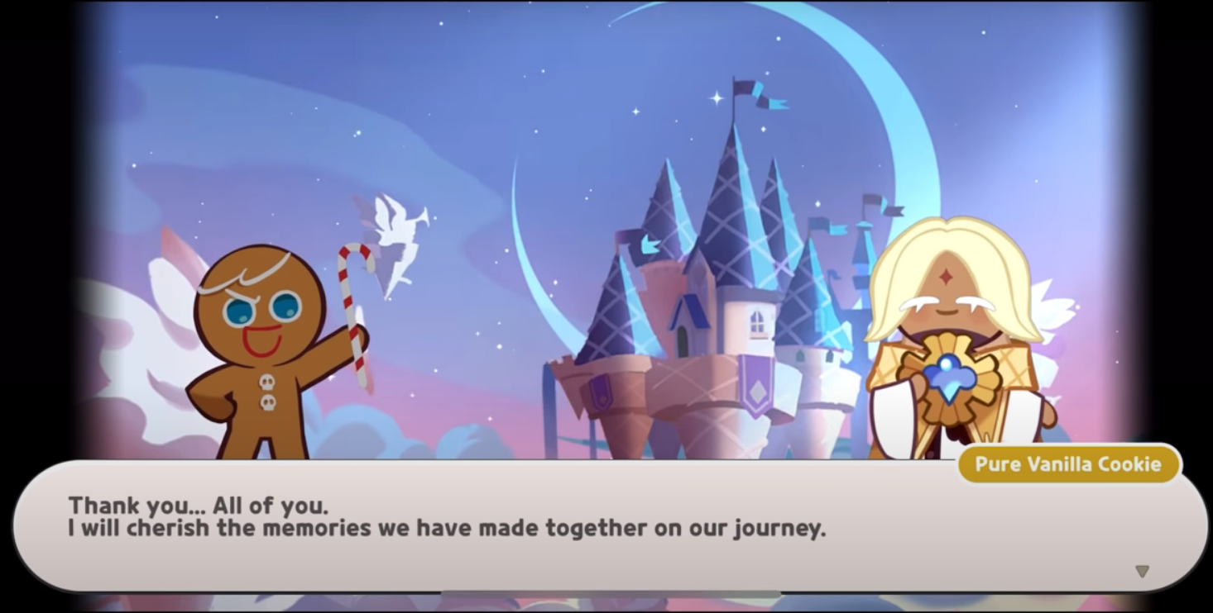

Slide 11
Should we end here?

Slide 12
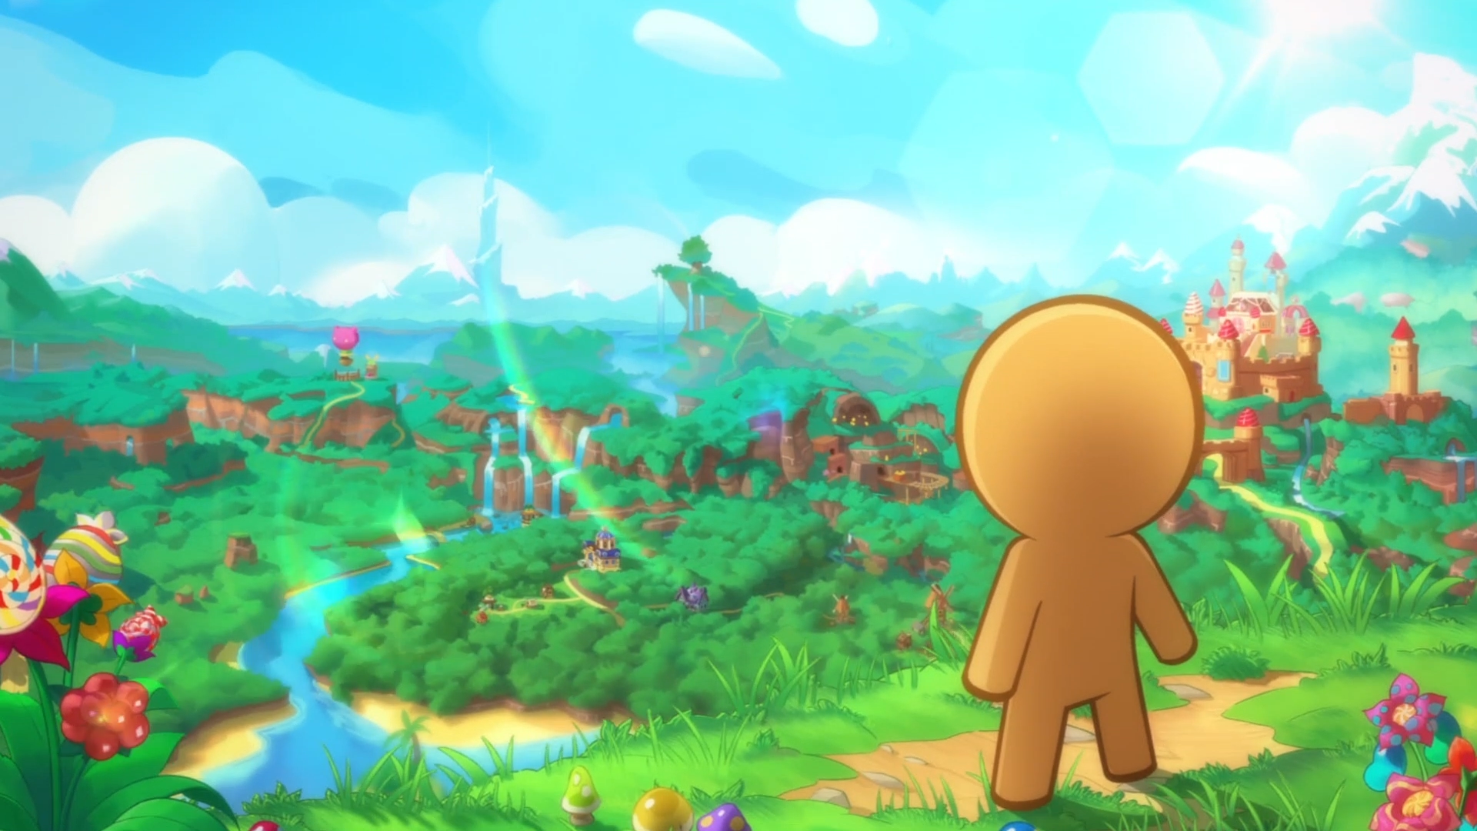
Have you heard “Five Minutes University”?
I believe that most of lectures and this class will be faded away soon!
So, I designed this presentation to be aesthetically pleasing, rather than highly academic!
-- This presentation should end here: think about what you will do after B.E. instead.

